Slide 1


WELCOME

Slide 2
Department of Computer Science and Engineering
DeepFruit: A Unified Deep Learning Framework for Fruit Classification and Quality Evaluation
PRESENTED BY
B. Yasaswini (21471A0512)
A. Vasavi (21471A0504)
N. Annapurna (21471A0538)
Under the Guidance of,
Dr.S.N.Tirumala Rao _{M.Tech , Ph.D. ,}
Professor & HOD,
Department of Computer Science and Engineering,
Narasaraopeta Engineering College (Autonomous),
Narasaraopet- 522 601.

Slide 3
OUTLINE
Abstract
Introduction
Literature Survey
Research Gaps
Problem Statement
Objectives
Block Diagram / Flow Diagram
Methodology
Implementation
Results and Analysis
Conclusion & Future Scope
References
Acknowledgements
Question and Answers

Slide 4
ABSTRACT
This study addresses fruit classification and grading, key aspects of agricultural automation, by leveraging transfer learning with pre-trained deep learning models.
Using the FruitNet Indian Fruits dataset with 19,400 images, it evaluates six fruit categories across multiple architectures, achieving a high accuracy of 99.7% with MobileNetV2.
The work highlights pre-processing's role in performance improvement and explores MobileNetV2's potential for efficient, scalable applications in agricultural automation.

Slide 5
INTRODUCTION
Brief Introduction to the Project
The project automates fruit classification and quality grading using MobileNetV2 and deep learning techniques.
It leverages transfer learning on a dataset of 19,400 images across six fruit types with quality labels (good, bad, mixed).
Motivation Behind the Project
Traditional fruit grading relies heavily on manual inspection, which is time-consuming and prone to human error.
Advancements in computer vision and deep learning offer an opportunity to streamline agricultural processes, reduce costs, and enhance precision.
Importance and Relevance
The project meets the need for efficient agricultural solutions to address global food demands.
It advances automation for quicker, more accurate fruit quality assessments and field decisions.

Slide 6
LITERATURE SURVEY
No | Title | Author | Journal Name & Year | Methodology Adapted | Key Findings | Gaps
1 | Multi-Fruit Classification and Grading Using a Same-Domain Transfer Learning Approach | Lama A. Aldakhil And Aeshah A. Almutairi | IEEE & 19 March 2024 | EfficientNetV2 Same-domain transfer learning approach for multi-fruit classification and grading using deep learning. Focused on data augmentation and pre-trained models. | Significant improvement in classification and grading accuracy. Reduced computational costs and improved generalization. | Limited dataset variety affects generalization Implement Instance Segmentation for Multiple Fruits
2 | Fruit Grading, Disease Detection, and an Image Processing Strategy | Sultanabanu, Kazi,Kazi, Kutubuddin | IEEE & June 30 2023 | CNN-based framework tailored for small datasets, incorporating data pre-processing and augmentation techniques. | Improved accuracy and effectiveness in crop quality assessments, supporting disease detection. Highlighted importance of fine-tuning for tasks. | Robustness in diverse conditions untested. Advanced architectures not explored.

Slide 7
LITERATURE SURVEY
No | Title | Author | Journal Name & Year | Methodology Adapted | Key Findings | Gaps
3 | Intelligent Fruit Quality Assessment Using CNN Transfer Learning Techniques | Divya Arivalagan; Paturi Nikitha; Manoj G; Jeevanantham C; Vignesh O | Research Gate & March 2024 | Developed a smart fruit classifier with transfer learning, focusing on model accuracy. | Demonstrated the necessity of improving classifier accuracy for real-world applications in fruit quality grading.. | Scalability to larger datasets and real-time needs requires work.
4 | Automated Fruit Grading in Precise Agriculture using You Only Look Once Algorithm | Weiwei Zhang | IJACSA, & 2023. | Employed YOLOv5 for automatic fruit grading and sorting. | Improved accuracy in complex grading tasks. Hybrid model outperformed CNNs in sequence tasks. | High computational requirements.
5 | DenseNet-201 and Xception Pre-Trained Deep Learning Models for Fruit Recognition | Farsana Salim, Faisal Saeed, Shadi Basurra, Sultan Noman Qasem, And Tawfik Al-hadhrami | IEEE & 19 July 2023 | Compared DenseNet201 and Xception for detailed fruit segmentation. | Attention mechanisms boosted interpretability and performance. | Real-time performance on constrained hardware untested.

Slide 8
LITERATURE SURVEY
No | Title | Author | Journal Name & Year | Methodology Adapted | Key Findings | Gaps
6 | Nutritional Quality of Fruits and Vegetables | Ariel R. Vincente , George A. Manganaris , Cristian M. Ortiz , Gabriel O. Sozzi , Carlos H. Crisosto | Research Gate & March 2024 | Analyzed the nutritional and non-nutritional antioxidants present in fruits and vegetables using DenseNet | Reduced computational costs and improved generalization. | Lack of a standardized definition for the Mediterranean diet.
7 | A cross-domain fruit classification method based on lightweight attention networks and unsupervised domain adaptation | Jin Wang, Cheng Zhang, Ting Yan, Jingru Yang, Xiaohui Lu, Guodong Lu & Bincheng Huang | Springer & 28 December 2022 | HAM-MobileNet Enhances feature extraction by reducing the influence of complex backgrounds. | The HAM-MobileNet model improves classification performance by suppressing background noise. | The study focuses on two datasets which may not fully generalize to other fruit types and environments.
8 | Efficient Adaptive Incremental Learning for Fruit and Vegetable Classification | kaitai guo, hongliang chen, yang zheng, qixin liu, shenghan ren , haihong hu and jimin liang | Research Gate & 12 June 2024 | ResNet34 with ADA-CIL approach serves as the feature extractor due to its deep residual learning capabilities. | Efficient Handling of Dynamic Learning Scenarios. adapts to new fruit and vegetable categories without full retraining. | Incremental learning methods often require significant storage and memory resources, making deployment on edge devices challenging.

Slide 9
LITERATURE SURVEY
No | Title | Author | Journal Name & Year | Methodology Adapted | Key Findings | Gaps
9 | Accurate classification of cherry fruit using deep CNN based on hybrid pooling approach | Mohammad Momeny, Ahmad Jahanbakhshi, Khalegh Jafarnezhad, And Yu-dong Zhang | ELSEVIER & August 2020 | Improved Convolutional Neural Network (CNN) with Hybrid Pooling Combines max pooling and average pooling to improve generalization. | Image processing and deep learning provide a more efficient and accurate solution for cherry grading than manual methods | Real-World Deployment Challenges Need for real-time processing validation in commercial cherry-packing facilities.
10 | Machine Learning–Based Detection and Sorting of Multiple Vegetables and Fruits | Anuja Bhargava, Atul Bansal, And Vishal Goyal | Research Gate & 30 August 2021 | Best performing model Support Vector Machine (SVM) classification. Achieved highest accuracy in both type detection (97.63%) and grading (96.59%). | Effective Feature Selection Enhances Performance. Segmentation Improves Classification | High computational requirements and Limited Dataset Scope

Slide 10
RESEARCH GAPS
Expand Classification to More Fruit Types : Extend the model to classify additional types of fruits and address a wider range of quality attributes, beyond just “Good” and “Bad,” to provide a finer granularity in quality grading.
Implement Instance Segmentation for Multiple Fruits : Develop the model to identify and classify each fruit individually in images with multiple fruits of mixed qualities, potentially using instance segmentation techniques.

Slide 11
PROBLEM STATEMENT
The paper addresses the dual challenge of fruit classification and quality grading, which is critical for agricultural automation. This includes identifying different types of fruits and assessing their quality (good, bad, or mixed) efficiently and accurately.
Significance of the Problem:
Human Reliance: Traditional grading heavily depends on manual inspection, which is time-consuming, inconsistent, and prone to errors.
Efficiency in Agriculture: Accurate fruit classification and grading are essential for streamlining agricultural processes, reducing post-harvest losses, and enhancing marketability.
Technological Gap: Previous studies focused on single-fruit classification or lacked robust methods to handle diverse conditions and real-time applications.
Scalability: Real-time and scalable solutions, particularly on constrained hardware, are necessary to make the technology accessible for farmers and agricultural systems globally.

Slide 12
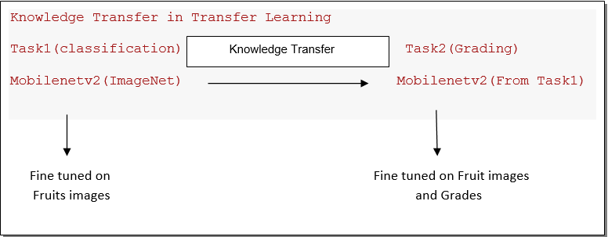
OBJECTIVES
Develop a Unified Framework
Ensure Robustness
Optimize Scalability
Compare Advanced Architectures
Leverage MobileNetV2 Using
Transfer Learning

Slide 13
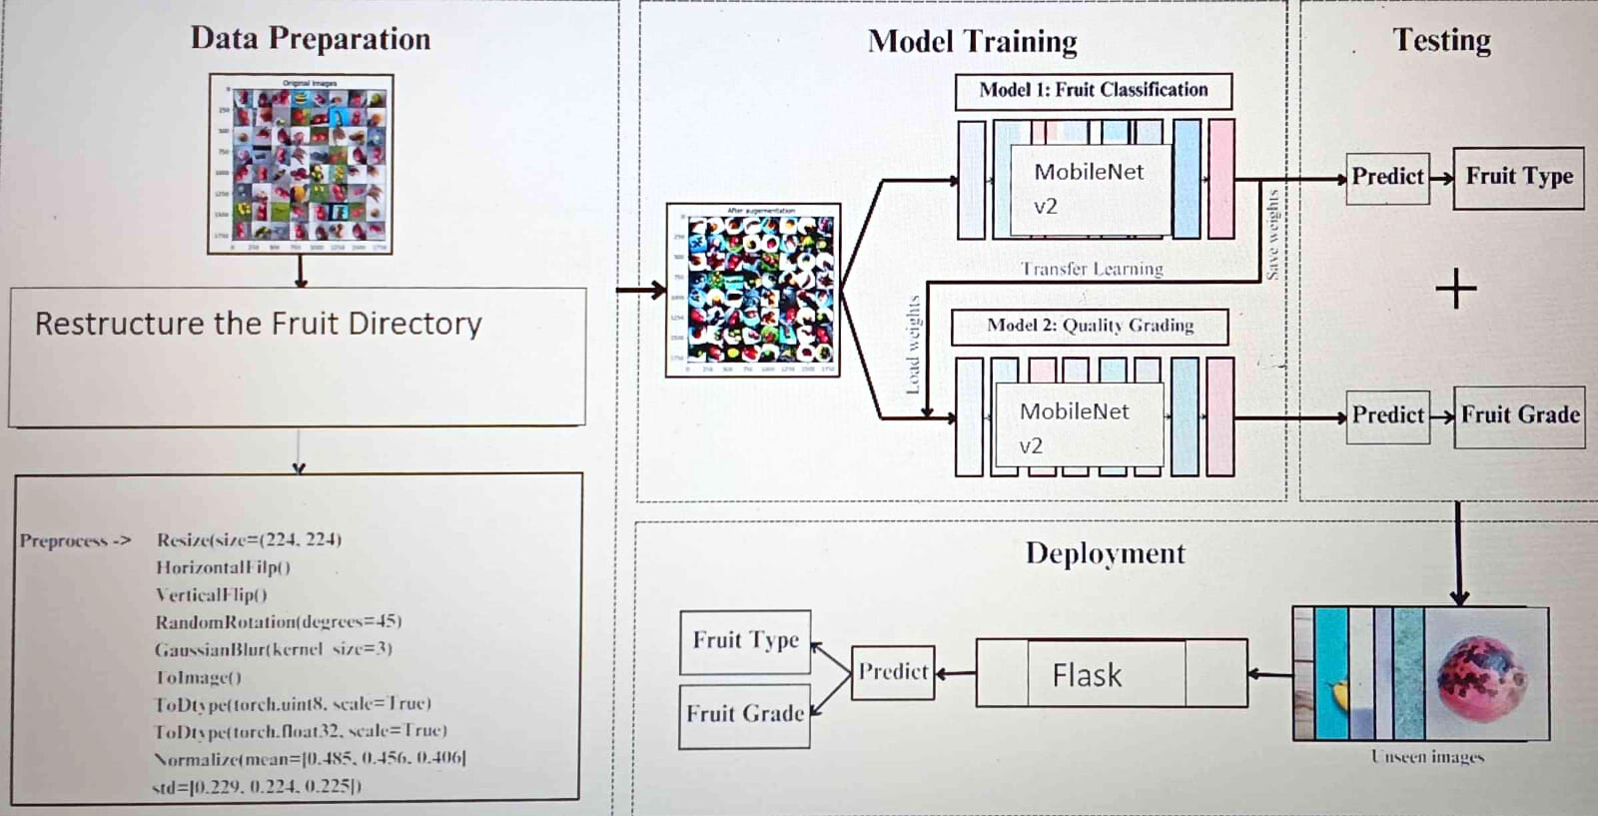
BLOCK DIAGRAM OR FLOW DIAGRAM

Slide 14
METHODOLOGY
Pre-Processing
Data Collection
Utilize a publicly available dataset like FruitNet, containing high-resolution images of various fruit
types and qualities.
Organize data into directories based on fruit type and quality categories.
Data Cleaning and Augmentation
Resize images to a uniform size (e.g., 128x128) for consistent input dimensions.
Apply techniques such as flipping, rotation, Gaussian blur, and normalization to enhance data
variability.
Data Splitting
Split the dataset into 80% training and 20% testing subsets.
Ensure balanced representation across all classes during splitting.

Slide 15
METHODOLOGY
Pre-Processing
Label Encoding
Convert textual labels (e.g., "apple_good") to numerical indices for compatibility with machine learning models.
Use one-hot encoding to prepare labels for multi-class classification.
Normalization
Scale pixel values of images from a range of 0–255 to 0–1 to improve model performance and training stability.
Integration with Libraries
Use Python libraries like NumPy for numerical operations, TensorFlow/Keras for model integration, and OpenCV for image manipulation.

Slide 16
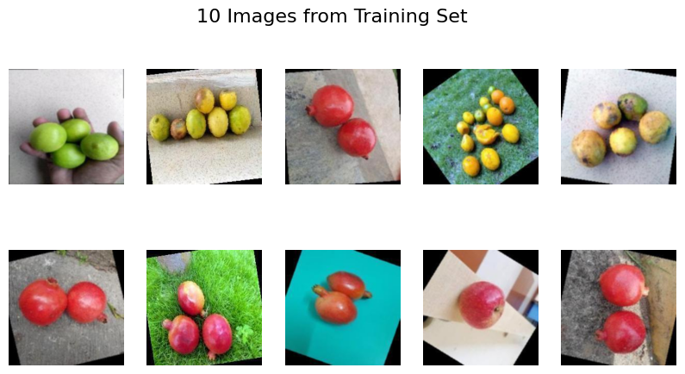
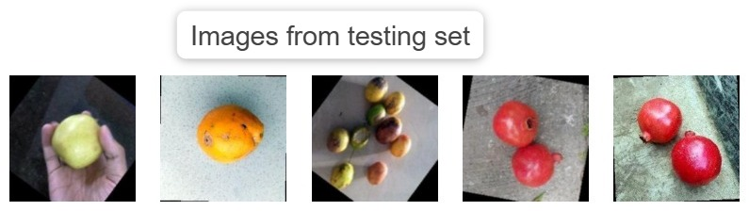
METHODOLOGY

Slide 17
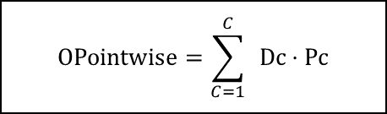
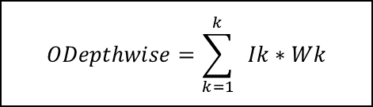
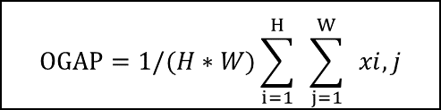
Framework Used:- MobileNetV2
Why MobileNetV2?
Optimized for mobile and edge devices.
Uses Depthwise Separable Convolutions for computational efficiency.
Lightweight architecture with high accuracy​
Layer(Type) | Output Shape | Param #
mobilenetv2_1.00_128 | (None, 4, 4, 1280) | 4,257,984
global_average_pooling2d | (None, 1280) | 0
dense (Dense) | (None, 256) | 527,936
dropout (Dropout) | (None, 256) | 0
dense_1 (Dense) | (None, 18) | 6,626
$$ODepthwise=\sum_{k=1}^{k}{ }Ik∗Wk$$
$$OPointwise=\sum_{C=1}^{C}{ }Dc⋅Pc$$
OInverted Residual​=OPointwise​+I
ReLU6(x)=min(max(0,x),6)
OBottleneck​=OPointwise_2​+I
$$OGAP​=1/(H∗W)\sum_{i=1}^{H}{ }\sum_{j=1}^{W}{ }xi,j$$

Slide 18
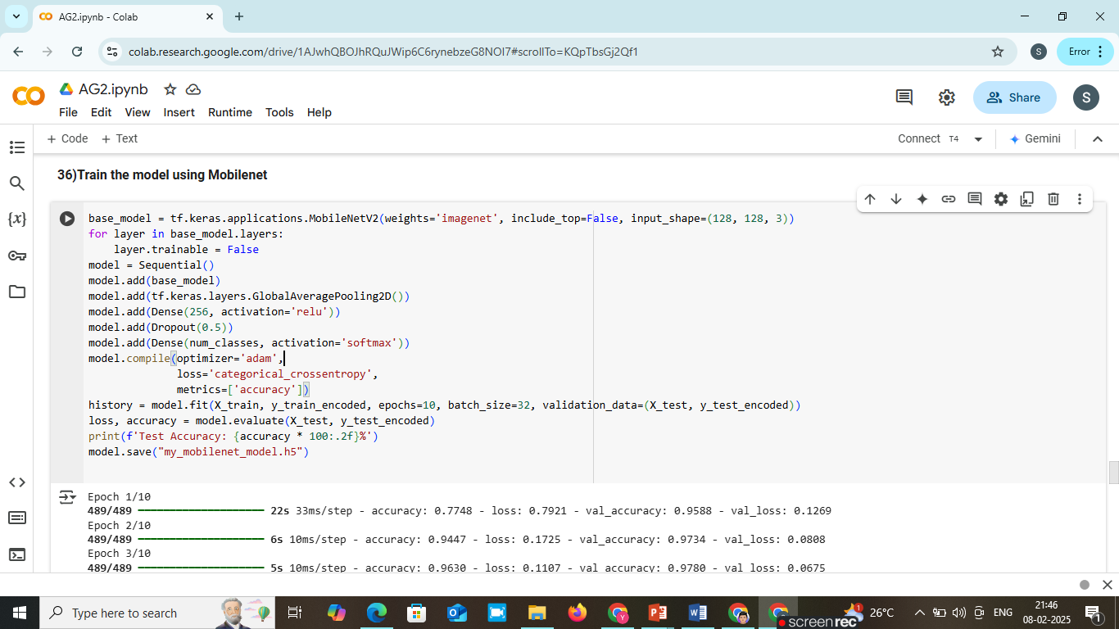
Implementation

Slide 19
System Requirements
Hardware Requirements
Processor : intel Core i5
Cache memory : 4MB(Megabyte)
RAM : 12.7GB (gigabyte)
Hard Disk : 166.8GB
Compute Engine : T4 GPU
Software Requirements
Operating System : Windows 10, 64-bit Operating System
Coding Language : Python
Python distribution : Google Colab Pro , Flask
Browser : Any Latest Browser like Chrome

Slide 20
Challenges Vs Overcomes
Challenges Faced | Solutions Implemented
Overfitting Due to Limited Data – Model had high training accuracy but poor generalization. | Data Augmentation – Applied rotation, flipping, contrast adjustment, and Gaussian noise to improve dataset diversity​
High Computational Costs – Training deep models required extensive processing power. | Use of GPU Acceleration – Utilized T4 GPU, reducing training time significantly compared to CPU
Class Imbalance in Dataset – Some fruit classes had significantly more images, causing biased predictions. | Class Weighting & Oversampling – Used oversampling and weighted loss functions to balance dataset distribution​
Environmental Variations – Different lighting and backgrounds affected model accuracy. | Preprocessing Pipeline – Standardized images by converting BGR to RGB, normalizing, and resizing uniformly
Feature Extraction Complexity – Differentiating good, bad, and mixed-quality fruits was difficult. | Transfer Learning with MobileNetV2 – Used pre-trained ImageNet weights, improving classification accuracy with fewer training samples​

Slide 21
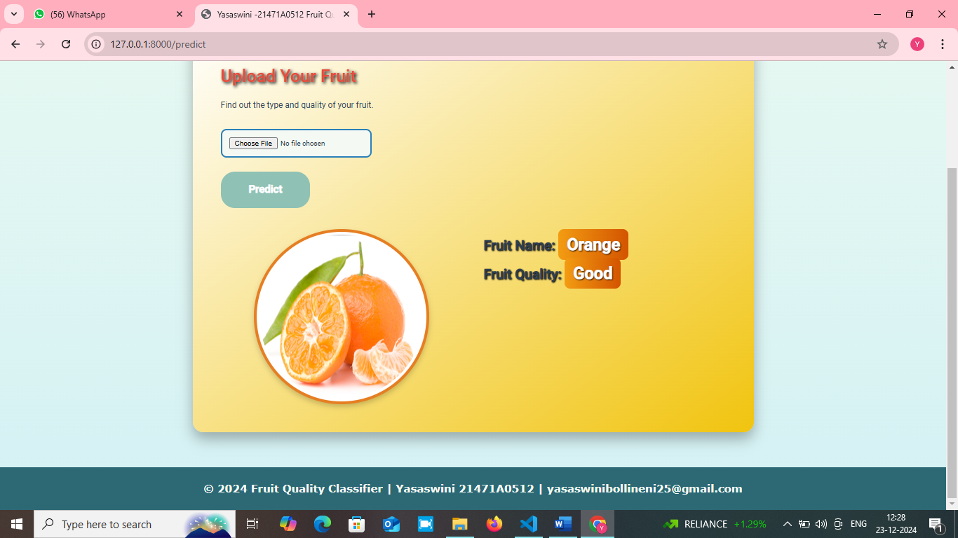
Implementation of Frontend

Slide 22
RESULTS & ANALYSIS
Model | Accuracy | Precision | Recall | F1-Score
MobileNetV2 | 99.7% | 0.98 | 0.98 | 0.97
EfficientNetV2 | 99.5% | 0.98 | 0.95 | 0.96
DenseNet | 98% | 0.97 | 0.97 | 0.97
NASNet | 97.6% | 0.96 | 0.98 | 0.98
VGG16 | 96% | 0.98 | 0.92 | 0.91
InceptionV3 | 95.75% | 0.95 | 0.98 | 0.97
Xception | 97% | 0.97 | 0.97 | 0.95
MobileNetV2 achieved the highest accuracy (99.7%), outperforming other models in precision, recall, and F1-score. EfficientNetV2 and DenseNet also showed strong performance, making them viable alternatives for fruit classification and grading.

Slide 23
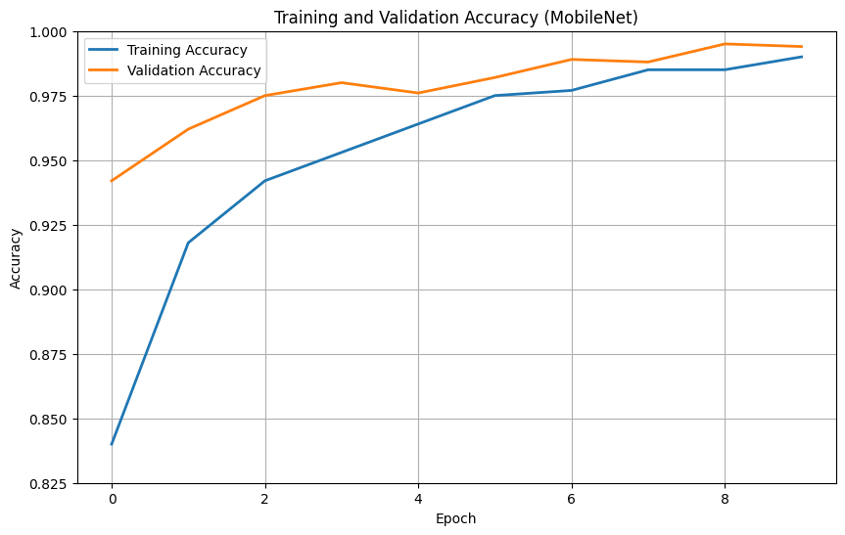
RESULTS & ANALYSIS
The graph depicts that, it can be observed that the training and validation accuracies of MobileNet rise up to 99% in 10 epochs with closely aligned curves.
It is a sign of good generalization without overfitting

Slide 24
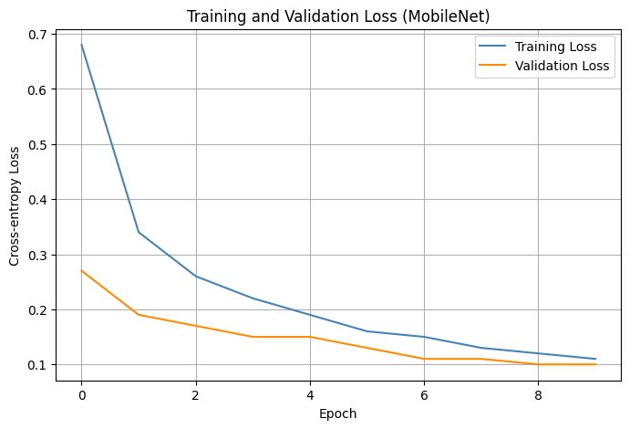
RESULTS & ANALYSIS
The graph depicts that the overall reduction of training and validation losses signifies that the MobileNet model learns well, and both losses are converging to 0.1. Since always the loss for validation is less than that of training.
This hints at good generalization and no signs of overfitting.

Slide 25
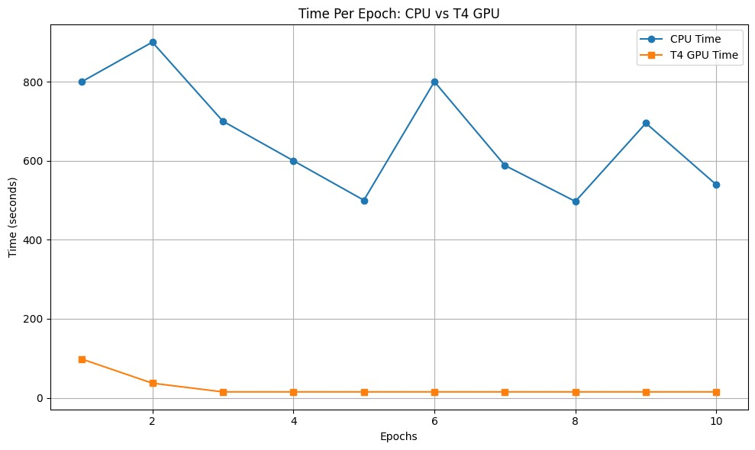
RESULTS & ANALYSIS
The graph depicts that, T4 GPU
significantly reduces the training
time per epoch compared to the
CPU,speeding up model
development and testing.
This makes it important for
high-performance machine
learning experiments.

Slide 26
CONCLUSION & FUTURE SCOPE
MobileNetV2 achieved the highest accuracy (99.7%) for fruit classification and quality assessment, outperforming EfficientNetV2 and DenseNet.
The twin-model framework, powered by deep learning and optimized data preprocessing, enabled accurate classification and grading of multiple fruit varieties.
This research demonstrates the potential of deep learning in revolutionizing agricultural automation, improving efficiency and scalability.
Real-time Implementation: Embedding the model into an automated machine vision system for real-time fruit classification and grading.
Enhanced Segmentation: Improving fruit segmentation techniques to focus on key image features, reducing noise from backgrounds.

Slide 27
REFERENCES
1. Ariel R. Vincente , George A. Manganaris , Cristian M. Ortiz , Gabriel O. Sozzi , Carlos H. Crisosto “Nutritional Quality of Fruits and Vegetables” DOI : https://doi.org/10.1016/B978-0-12-408137-6.00005-3
2. Anuja Bhargava, Atul Bansal, And Vishal Goyal “Machine Learn ing–Based Detection and Sorting of Multiple Vegetables and Fruits”, DOI: https://link.springer.com/article/10.1007/s12161-021-02086-1, 30 August 2021, Volume 15.
3. Hafsa Raissouli, Abrar Ali Aljabri, Sarah Mohammed Aljudaibi, Fazilah Haron, And Ghada Alharbi “Date Grading using Machine Learning Techniques on a Novel Dataset”, DOI: 10.14569/IJACSA.2020.0110893.
4. Lama A. Aldakhil And Aeshah A. Almutairi “Multi-Fruit Classification and Grad ing Using a Same-Domain Transfer Learning Approach”, Digital Object Identifier (DOI): 10.1109/ACCESS.2024.3379276, March 2024.
5. Mohammad Momeny, Ahmad Jahanbakhshi, Khalegh Jafarnezhad, And Yu-dong Zhang “Accurate classification of cherry fruit using deep CNN based on hybrid pooling approach”, DOI: https://doi.org/10.1016/j.postharvbio.2020.111204.
6. Dhiya Mahdi Asriny, Septia Rani, And Ahmad Fathan Hidayatullah “Orange Fruit Images Classification using Convolutional Neural Networks”, DOI: 10.1088/1757 899X/803/1/012020.
7. Sultanabanu Kazi,Kazi Kutubuddin “Fruit Grading, Disease Detection, and an Image Processing Strategy” e-ISSN: 2581-3803 Volume-9.
8. Divya Arivalagan; Paturi Nikitha; Manoj G; Jeevanantham C; Vignesh O “Intel ligent Fruit Quality Assessment Using CNN Transfer Learning Techniques” doi: 10.32629/jai.v7i4.1424
9. WEIWEI ZHANG, “Automated Fruit Grading in Precise Agriculture using You Only Look Once Algorithm”, International Journal of Advanced Computer Science and Applications (IJACSA), Vol. 14, No. 10, 2023.
10. Farsana Salim, Faisal Saeed, Shadi Basurra, Sultan Noman Qasem, And Tawfik Al-hadhrami “DenseNet-201 and Xception Pre-Trained Deep Learning Models for Fruit Recognition”, https://doi.org/10.3390/electronics12143132, 19 July 2023.

Slide 28
ACKNOWLEDGEMENTS
We would like to express our sincere gratitude to the faculty and staff of Narasaraopeta Engineering College for their guidance and encouragement throughout the development of this project. Their insights and expertise have been invaluable.
We also extend our thanks to the administration for providing the necessary resources and a platform to showcase our work. This opportunity has been instrumental in enhancing our learning and growth.
For any questions or further discussions, feel free to reach out:-
Email: yasaswinibollineni25@gmail.com Phone: 8247626375
Email: vasaviaravapalli2004@gmail.com Phone: 7093760074
Email: annapurnanakka538@gmail.com Phone: 7702351758

Slide 29
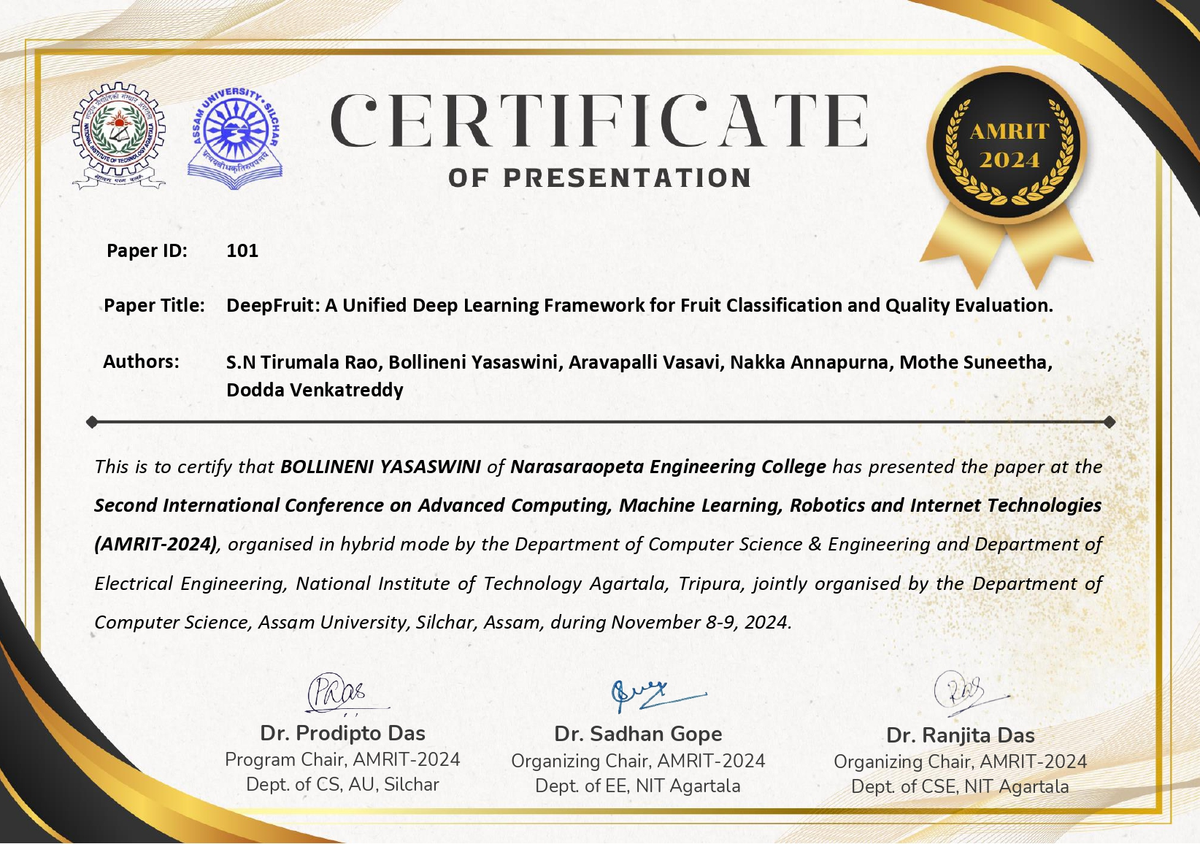

Slide 30
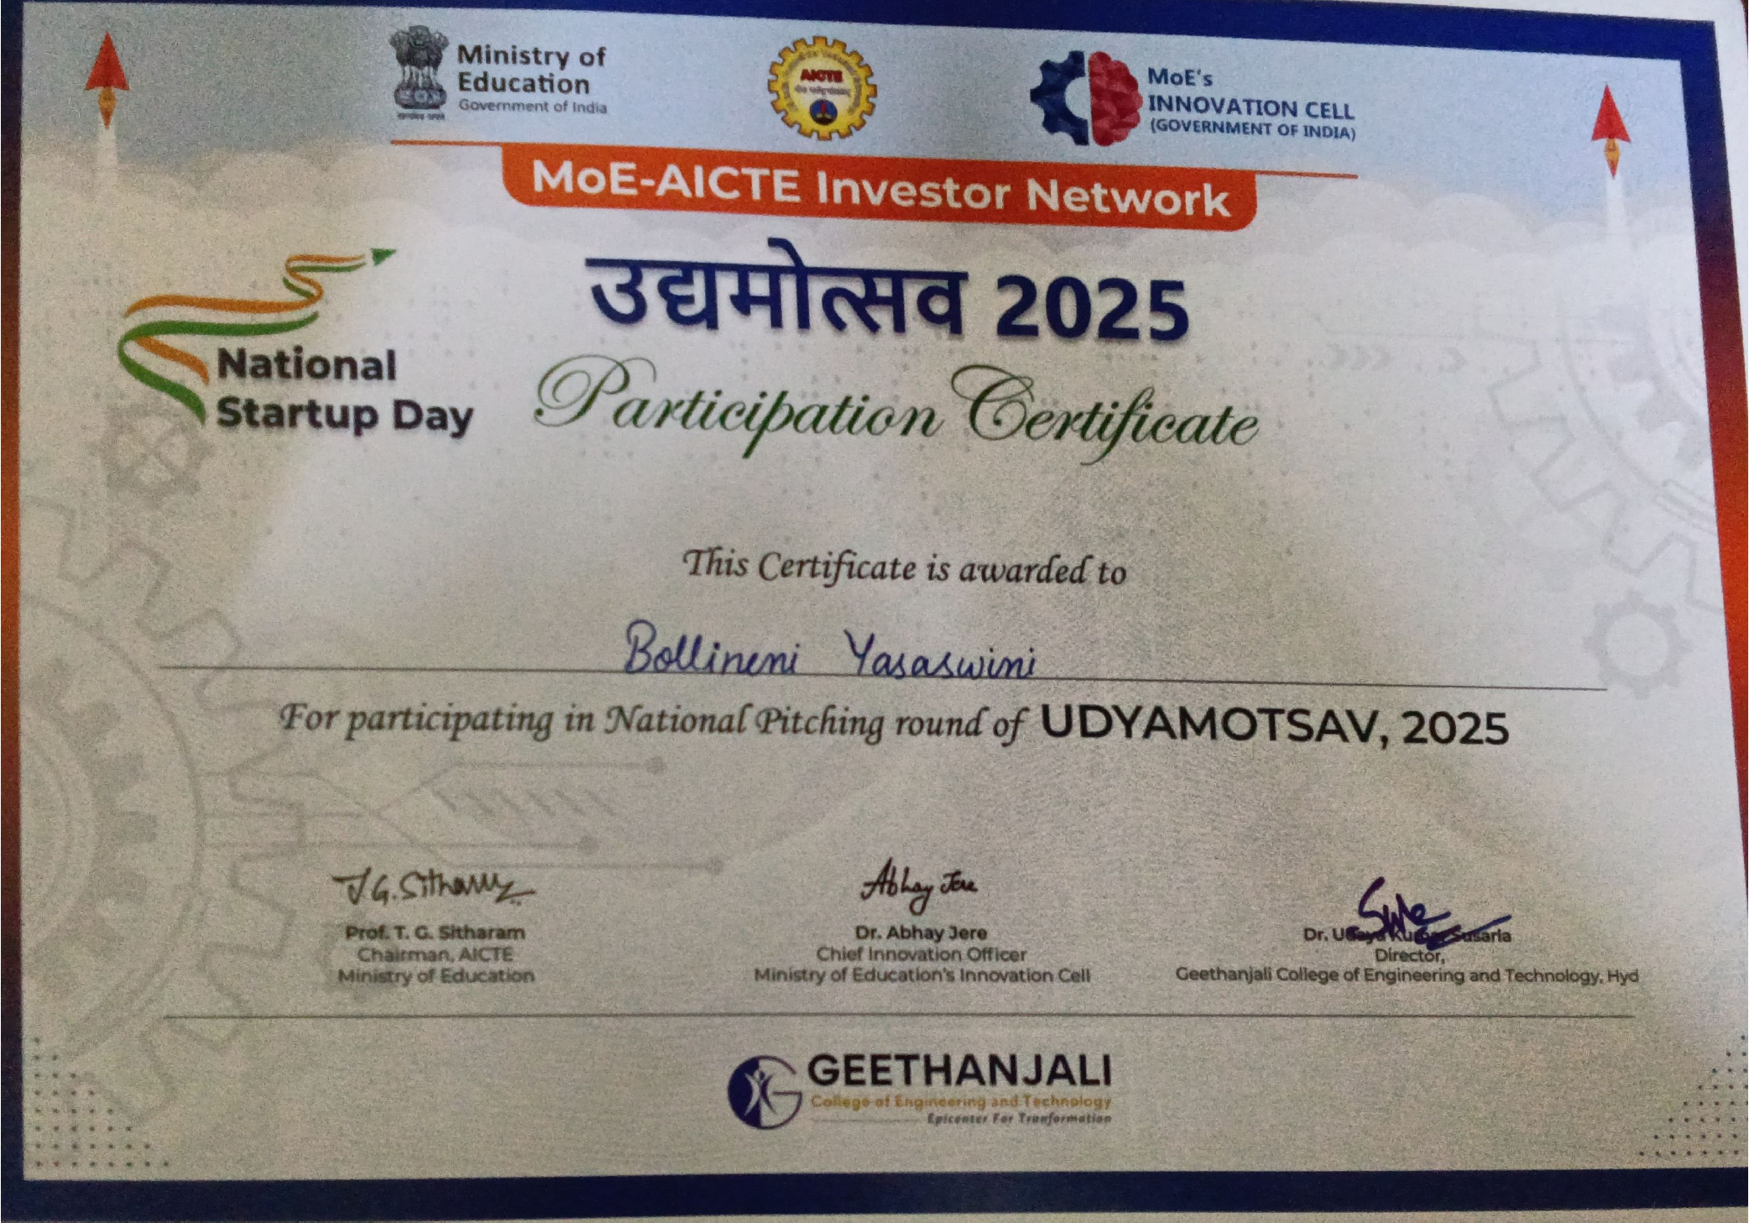

Slide 31


Slide 32


